Slide 1

Energy Consumption Forecasting
Final Presentation
Adriana Matos, Hamzah Issa, and William Appelt
May 5, 2025
Notes:
Hello everyone, and thank you for being here today.
My name is Hamzah Issa and those are teammates — Adriana and Will. Today we will be presenting our final project on Energy Consumption Forecasting.
We’ve spent the semester developing and testing a model to better predict how much energy is used in Texas, especially during extreme weather.
Today, we’ll walk you through our process, our results, and what we learned.

Slide 2

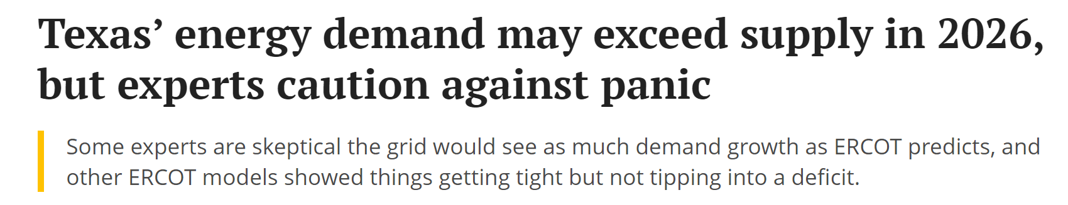
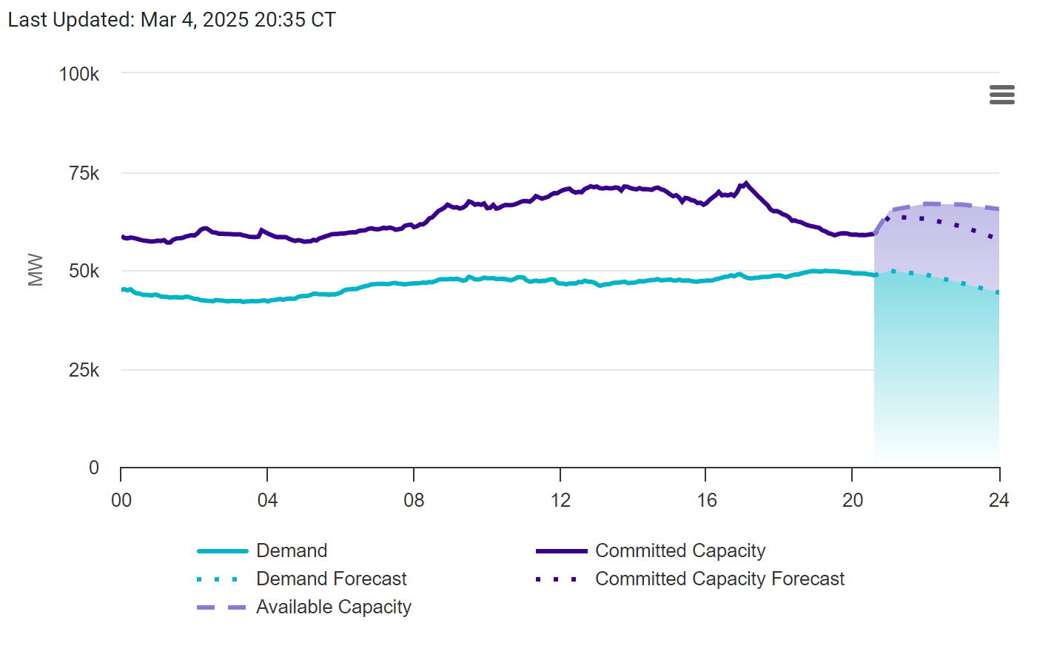
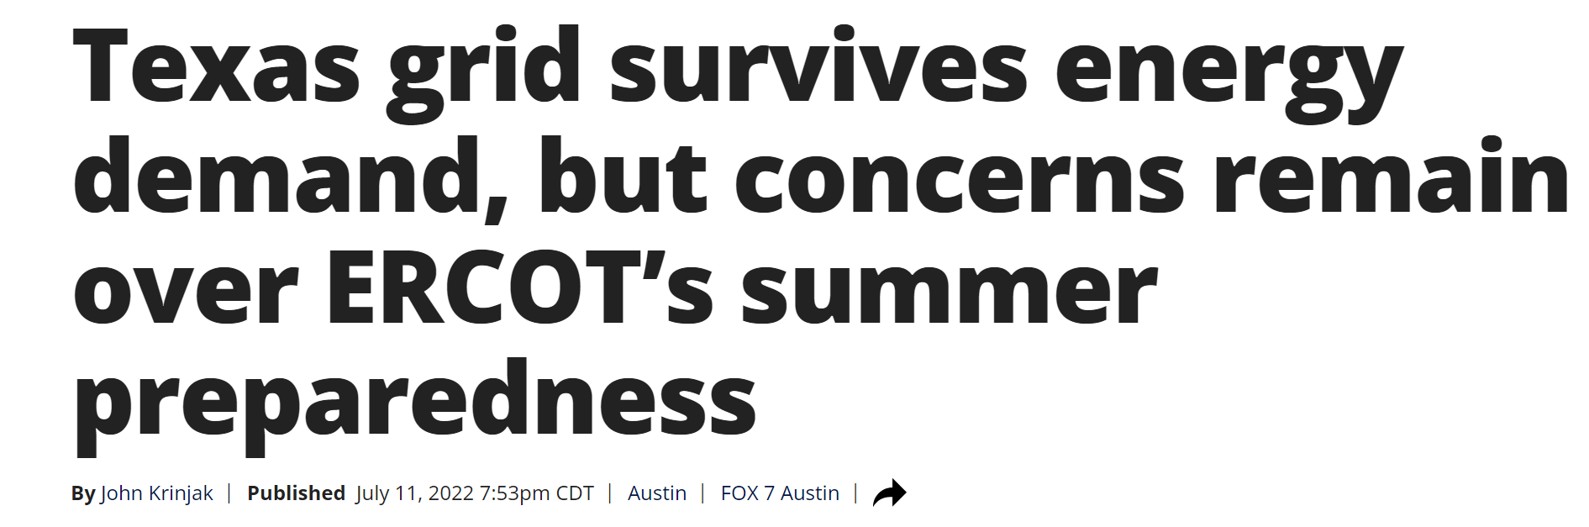
Problem Tackled
Texas experiences extreme energy demand fluctuations.
Better forecasting can prevent blackouts and optimize power generation.
We need an accurate model to predict energy usage.
Notes:
So in Texas, energy demand doesn’t stay steady — it jumps up and down a lot depending on the weather, time of day, and even sudden events like heat waves or winter storms.
For example, during a summer afternoon, demand can go way up as everyone turns on their AC at the same time. And if the grid isn’t ready for it, that can cause blackouts or rolling outages.
That’s what we’re showing here with the chart on the left. The blue line is demand, and you can see how it climbs during peak hours. The shaded area shows when capacity starts getting close to its limit.
On the right, we added two recent news headlines. One says demand might go over supply by 2026, and the other talks about how ERCOT barely kept up with demand during the summer.
These examples show why forecasting matters — if we can predict when and how much energy will be used, utilities can plan better, bring extra resources online ahead of time, and avoid emergencies.
So that’s the problem we wanted to help with — building a smarter way to forecast energy demand more accurately

Slide 3
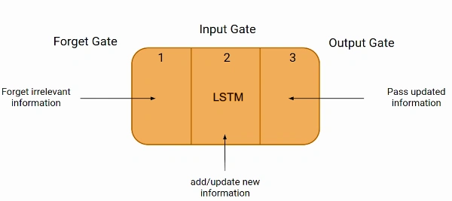
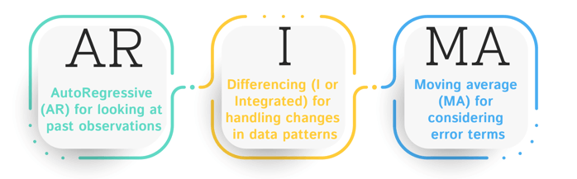
Current Methods & Their Limitations
Traditional Models: ARIMA (Autoregressive Integrated Moving Average), LSTMs (Long Short-Term Memory).
Limitations:
ARIMA struggles with nonlinear trends.
LSTMs have trouble capturing long-term dependencies.
Notes:
Before we built our model, we looked at some of the common forecasting methods already used.
Two popular ones are ARIMA and LSTM. ARIMA stands for Auto-Regressive Integrated Moving Average. It’s more of a traditional statistical model that looks at patterns in past data.
Then we have LSTMs, or Long Short-Term Memory networks. These are a type of neural network that tries to remember past information over time.
But both of these have problems. ARIMA doesn't handle sudden or nonlinear changes very well — like when a heatwave suddenly increases demand.
And even though LSTMs are better with patterns, they still struggle when the input depends on something that happened a long time ago — like last week’s weather still affecting usage today.
So we knew we needed something stronger — and that’s where Transformers come in.

Slide 4
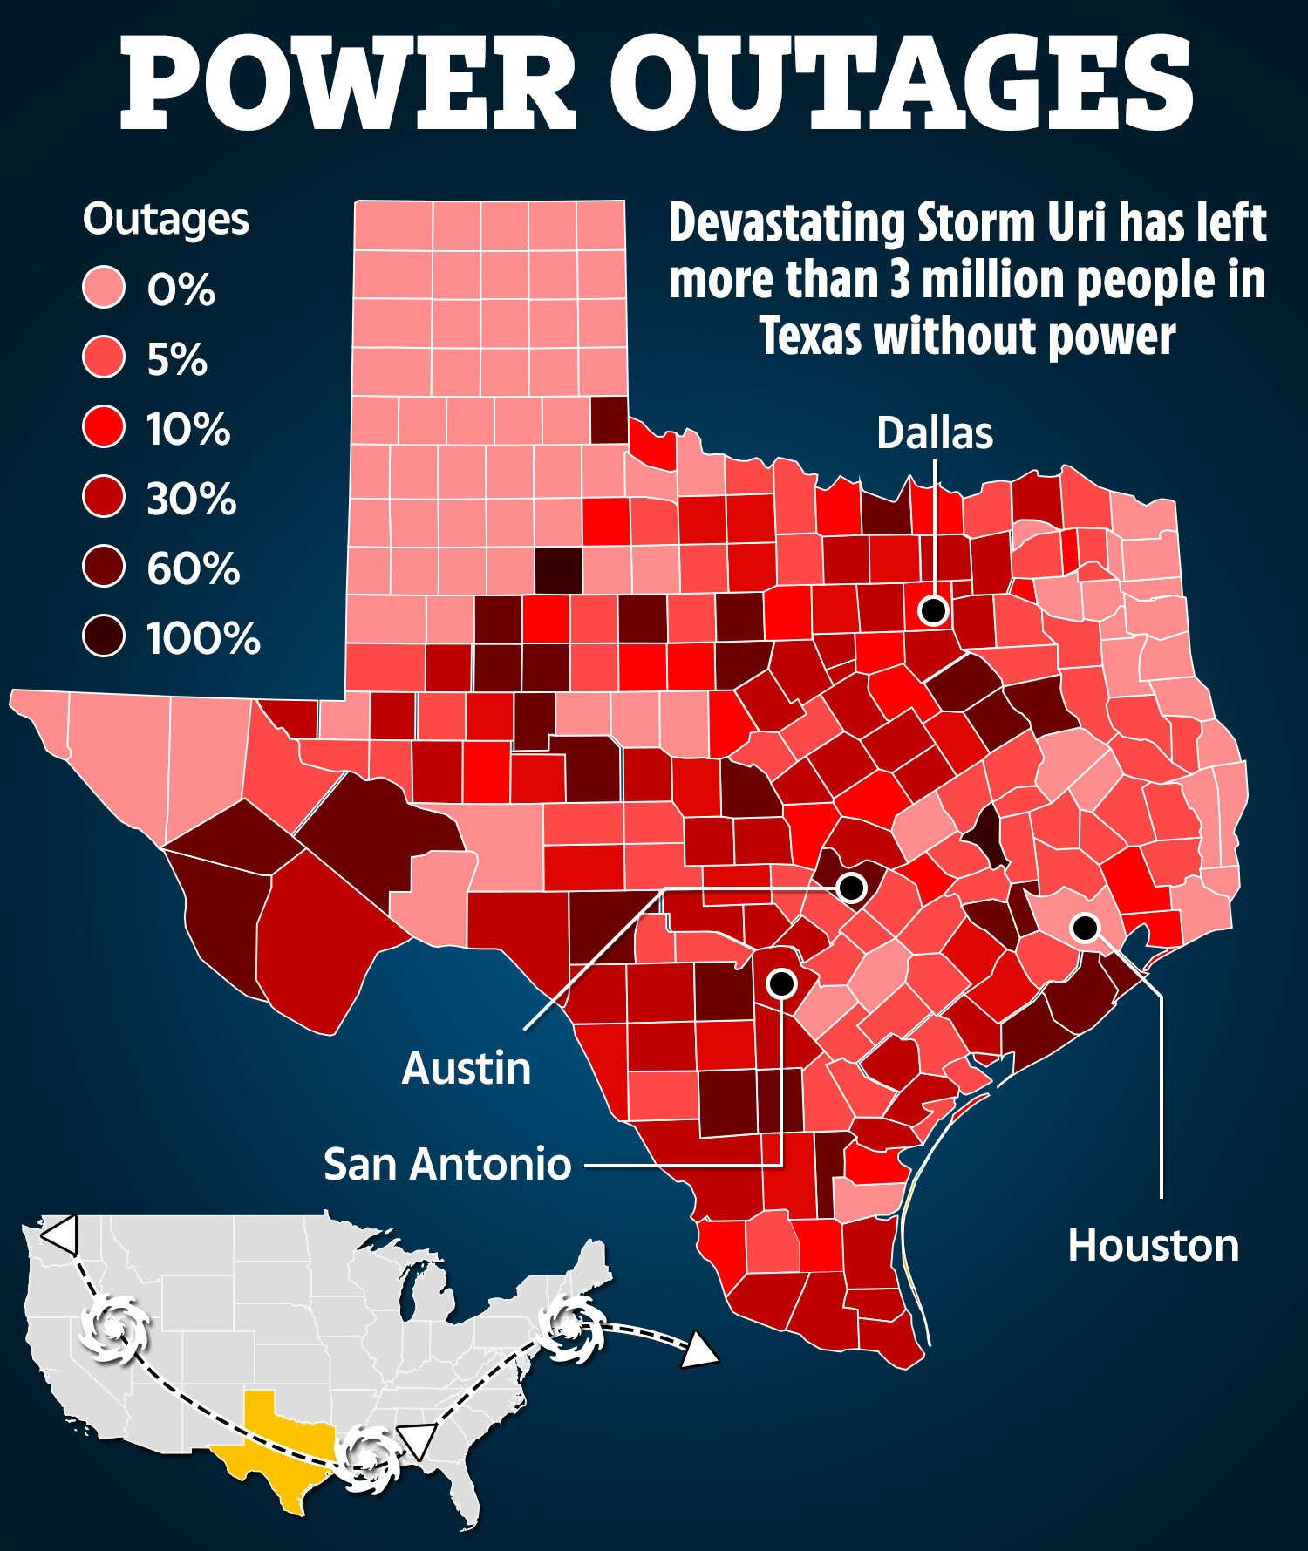
Our Proposed Solution - Transformer Model
Why Transformer-based model?
Captures long-range dependencies better.
Uses self-attention to focus on important trends.
Performs well on time-series forecasting.
Notes:
Transformers were originally designed for language models like ChatGPT, but they actually work really well for time-series data too — like predicting energy usage.
One big advantage is that Transformers can remember long-term patterns better than LSTMs. So if energy demand today depends on something that happened several days ago, it can still catch that.
Another strength is something called self-attention. This lets the model focus more on important data points instead of treating everything equally. It kind of “pays more attention” to what's most relevant.
And in general, Transformers have been shown to perform really well for forecasting problems, especially when there's a lot of complex input like weather and time.
On the right, we included a graphic from the winter storm in 2021. This shows how serious power outages can be. We think models like ours can help predict high-demand periods early, so utilities can get ahead of it.

Slide 5
Model Plan
Our model pipeline begins with data cleaning and aggregation, followed by training a Transformer network on time-aligned energy and weather data.
The model captures both immediate and long-term consumption patterns.
Evaluation against real ERCOT data confirms improved accuracy over traditional models.
01
Data Processing
Handle missing values
Normalize data
Match hourly and daily data to get weekly
02
Transformer Model Trains
Combine historical energy and weather data
Match data to produce weekly which will make the model more efficient
03
Transformer Model
Train on time series sequences
Train on edge cases
04
Evaluation and Results
Compare with actual data to ensure model is accurate
Generate CSV files and graphs to visualize data
Notes:
Here’s an overview of how we built and tested our model.
First, we started with data processing. We cleaned the ERCOT energy data and the NOAA weather data, filled in any missing values, and then combined them. Since the energy data was hourly and the weather was daily, we had to match them carefully — eventually creating weekly sets to improve training.
Next, we moved on to training the Transformer model. We combined both energy and weather inputs, and we trained the model to recognize weekly patterns and how the weather affects energy demand.
Then comes the actual Transformer stage, where the model trains on time-series sequences. We also tested it on special edge cases — like days with really high or low demand — to see how it would handle extreme situations.
Finally, we evaluated the results and compared the data the model gave us to previous data collected.
The overall takeaway here is that our model did better than traditional ones, especially in capturing both short-term and long-term trends.

Slide 6
Project Methodology
Combined energy consumption and weather data into one set to feed as Training Input
Transformer Training with inputted .csv file
Input .csv file with up to 10 days in advance of weather data provided by a chosen source to get an outputted .csv file with the estimated energy consumption for those days
Notes:
Yap about the steps for the project… “Currently our project takes in an inputted .csv file, created by us, with weather data from up to 10 days in advance. This number is based off of the common 10-day weather forecast weather websites provide. We tested our model with 7 day weather forecast of predicted high, low and precipitation data to provide us with an updated .csv file that contains the energy consumption estimation as well as a graphical representation showing the difference in the previous year’s energy consumption of those specified dates vs. the predicted energy consumption.

Slide 7
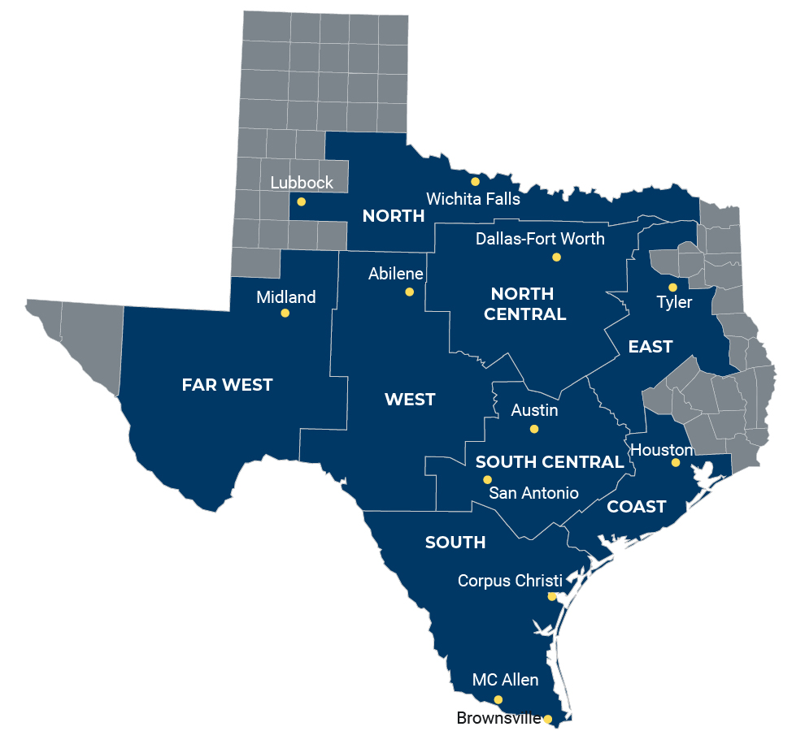
Data Sources & Preprocessing
Data Sources:
ERCOT hourly energy usage data 2024-Feb 2025
NOAA Houston daily weather data 2024-Feb 2025
Preprocessing:
Handle missing values.
Normalize data (Average hourly ERCOT data with daily weather data)
Notes:
Our data will come from ERCOT, which tracks Texas electricity usage, and NOAA, which provides weather information. We’ll clean the data, remove missing values, and add features like temperature and time of day. Unfortunately, we came to a roadblock when trying to access public weather data. While we were able to easily access ERCOT hourly data for all of Texas, it proved difficult to access hourly weather data for all of Texas. However, to get over this roadblock we narrowed our search to just a Houston based station instead of all of Texas and we were able to find daily weather data. Since both these data sets were different in times (hourly vs. daily), we created a code to average the ERCOT hourly data, so we can match it to the daily weather data from Houston (mainly high and low temperatures and precipitation values). We also made sure to narrow the ERCOT data to just the Houston region, namely the COAST region (as we can see in the picture sourced from the ERCOT website of their different weather zones), before completing this average. This was able to serve as more of a proof of concept build with just the narrowed down data, but can later be improved by inputting data for all of Texas and outputting the estimated energy consumption. Due to the difficulties with data collection, we decided to stick to training our model with just a little over a year of data (2024-Feb 2025), straying from the original plan to go as back as when the winter storm took place in 2021 since it would’ve been a good edge case test opportunity. To improve we can better our data acquisition to see if we can find weather data dating as far as 2021 or even farther, so we can train our model to give even more accurate predictions.

Slide 8
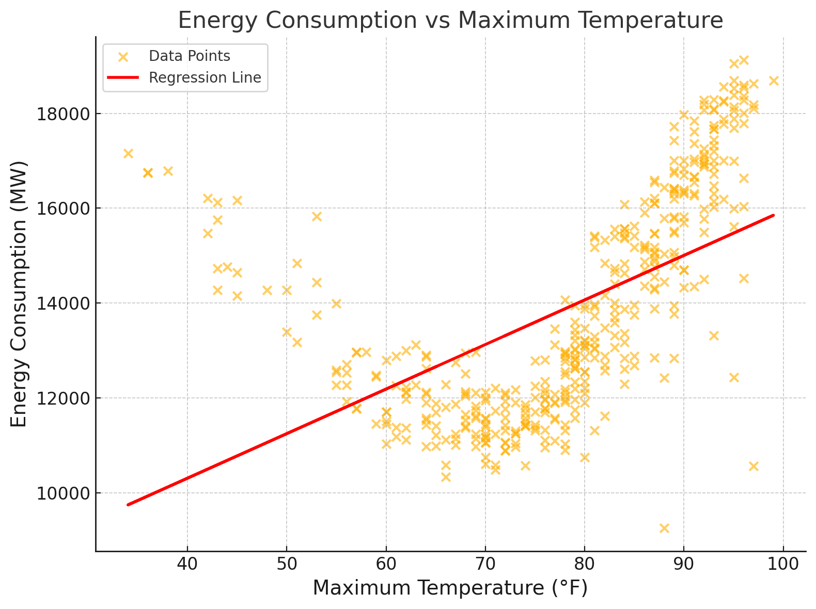
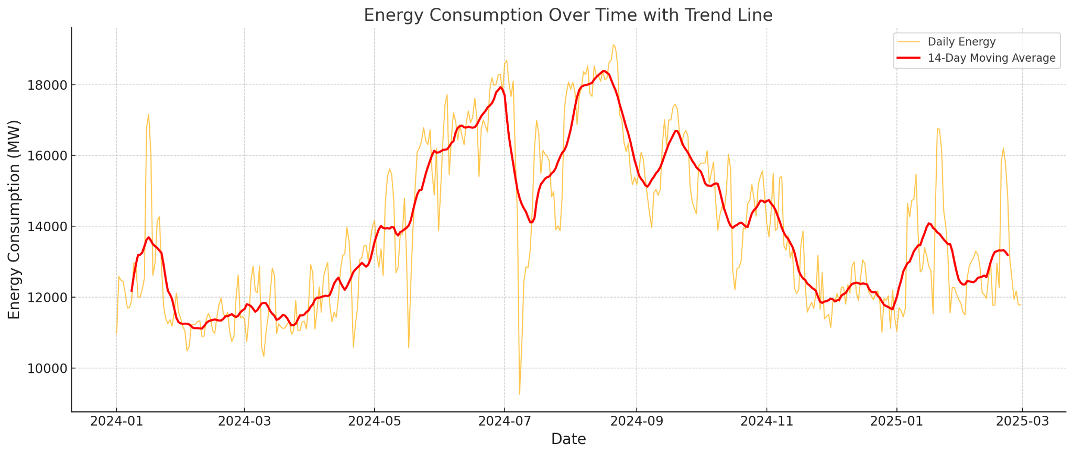
Data Analysis
Notes:
Using the data for Training the model (i.e. the ERCOT and NOAA data), we also created a graph to help us visualize the data. We created two graphs: how the max temperature relates to the energy consumption as well as the energy consumption over the whole period we acquired. As we can see the max temperature and energy consumption graph has a positive correlation seen through the regression line, which is what we expected, but we can also see it has a parabolic relationship showing that there is high energy consumption with colder temperatures (<50) and higher temperatures (>80) vs. lower energy consumption with warm temperatures, namely between the 60-80 degree range. The energy consumption over time graph shows us the different seasons and their energy consumption. We can see that Texas can really only get 2 seasons, summer and winter/ hot and cold (LOL).

Slide 9
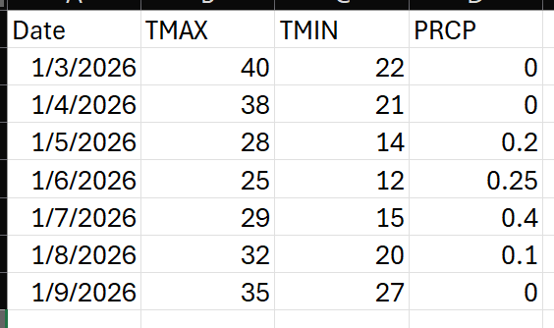
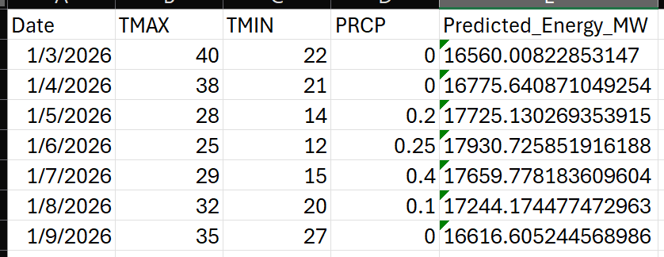
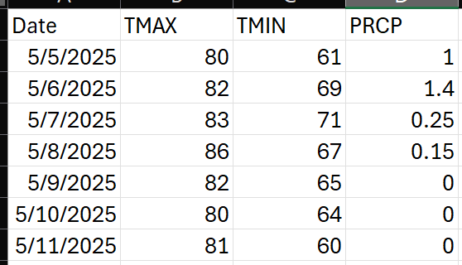
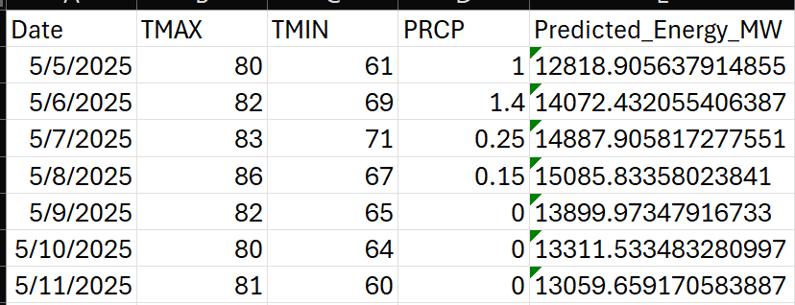
Actual vs. Expected Results
Input .csv:
Output Updated .csv:
Notes:
Pivoting to the actual data inputted into our model, this slide shows some of the input data we used to test that our model was working. We tested it with real predicted weather data for the week of May 5th- May 11th (acquired from Apple Weather app) and fake data for future 2026 dates, one in “summer” weather and one in “winter” weather. The comparison graphs, shown in the next slide, are of these two data sets. The updated .csv file shows the data from the original inputted file as well as the predicted energy over the trained area in MegaWatts

Slide 10
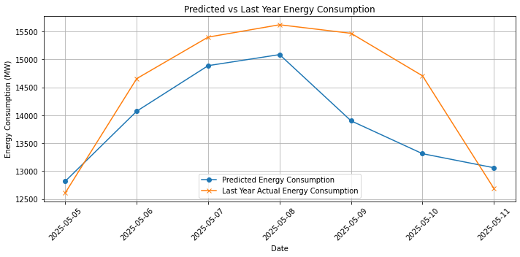
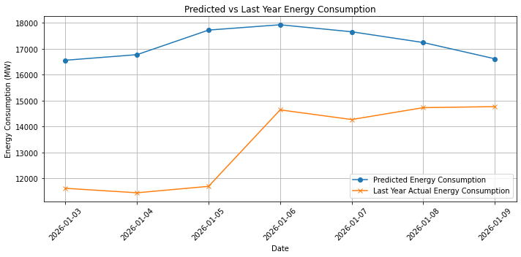
Actual vs. Expected Results
Notes:
As we can see, the model is able to predict both more or less energy consumption than compared to the previous year, showing that is is not just following season trends, but basing its predictions on the temperatures instead.

Slide 11
Analysis & Conclusions
Overall, the model results were very consistent with the actual weather and energy consumption data trends.
Results showed improvements over the state-of-the-art base model.
The main disadvantage with the model, as stated earlier, is the limited data used for training resulting from public weather data availability issues.
 | RMSE (MW) | MAPE (%) | R²
ARIMA | 1050 MW | 7.2% | 0.875
LSTM | 760 MW | 5.1% | 0.913
Transformer | 630 MW | 3.8% | 0.925

Slide 12
Future Directions
Model can be improved in future versions with better availability of older ranges of public weather data.
Updating the model quarterly or even annually can help to provide the most up-to-date information for more accurate forecasting. This also allows for population growth to be accounted for in future energy consumption predictions.
Model could be expanded to include the entirety of Texas, and then even further to include the rest of the United States.

Slide 13
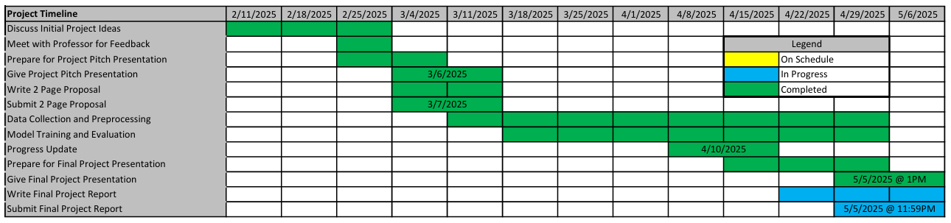
Project Timeline (Milestones)

Slide 14
Conclusion & Q&A
Thank you!
Questions?
Notes:
In summary, our goal is to make energy forecasting more accurate by using Transformers. We’ll compare our results to LSTM models to see the improvements. Thank you for listening! We’re happy to answer any questions.

